Slide 1
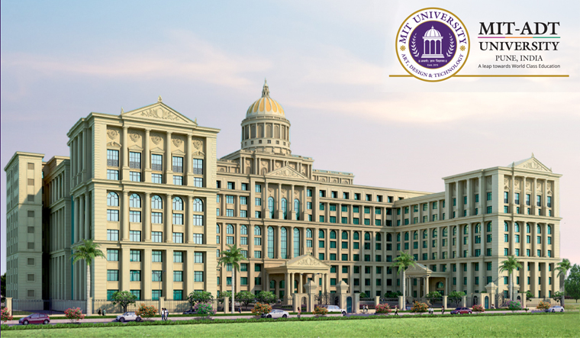
MIT ART DESIGN AND TECHNOLOGY UNIVRSITY (PUNE ,MAHARASHTRA) Established by Govt of Maharashtra by MIT ADT University ACT No.XXXIX of 2019 MIT SCHOOL OF ENGINEERING

Slide 2

THIS PROJECT IS BASED ON DESIGN OF SMALL SCALE WATER TREATMENT PLANT{MODEL} PROJECT GUIDE:- Prof. Gauri Desai PRESENTED BY :- ABHISHEK GODPATLE (2192003) YASH ATUL RAMTEKE (2202516) ROHIT SHIRKE (2192021) Harshvardhan Patil (2202519) GROUP NO. 10

Slide 3
TABLE OF CONTENTS
INTRODUCTION
OBJECTIVES OF PROJECT
METHODOLOGY
LITERATURE REVIEW
SCOPE OF THIS PROJECT

Slide 4
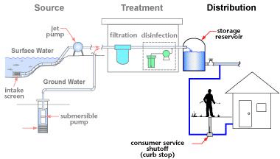
INTRODUCTION
Drinking water treatment plants are used to remove particles and organisms that lead to diseases and protect the public’s welfare and supply pure drinkable water to the environment, people and living organisms. In addition, they also provide drinking water that is pleasant to the senses: taste, sight and smell and provide safe, reliable drinking water to the communities they serve.
Page no.: 1

Slide 5
Objective of project
To study process of water treatment plant.
To perform Various Test on different source of water samples.
To encourage Construction of small scale water treatment plant in Rural regions
Page no.: 2

Slide 6
LITERATURE REVIEW:-
Author | Year | Research Title | Findings
Yian Wang | 2021 | Research Progress of Tap Water Treatment Process | There are more and more treatment processes for purifying tap water, but each has its advantages and disadvantages. Therefore, in practical applications, we need to select the treatment process following the actual situation to achieve the purpose of purifying tap water
Mohamed Farhaoui | 2016 | Review on Optimization of Drinking Water Treatment Process | This paper has presented some results concerning many practical methods used in the management of the water treatment plant, the use of sludge as coagulant aid with the aluminum sulfate in the water treatment plant. The sludge improves the quality of the produced water by increasing the coagulation efficiency and the aluminum sulfate dosage is decreased.
Belay Desye | 2021 | Efficiency of Treatment Plant and Drinking Water Quality Assessment | Based on the results, some of the investigated parameters of water quality (turbidity, RC, TC, and FC) were found to be not within the permissible limits of WHO guideline values for drinking water quality
Gaurank Patil | 2018 | Study of Water Treatment Plant Jalgaon | The current workers and officers working in water treatment plant are quite less and should be increase to required level.
Mudassir M Inamdar | 2018 | Performance of Drinking water treatment Plant | To implement performance assessment, it is necessary to develop adequate and representative performance indicators. Good performance indicators can specify the measurable evidence that is necessary to document the achievement of a g al

Slide 7
METHODOLOGY
SOURCES:-
Rainwater Based
Groundwater Based water supply
Surfacewater based water supply
The following are Major water Treatment process.
Coagulation.
Flocculation.
Sedimentation.
Filtration.
Disinfection

Slide 8
SCOPE OF THIS PROJECT.
In planning a water treatment plant (small scale) the following points need to be considered:
1. Source of water
2. Quality of water
3. Population
4. Current Source of Usable Water
5. Water Treatment System
6. Advantages
7. Disadvantages

Slide 9
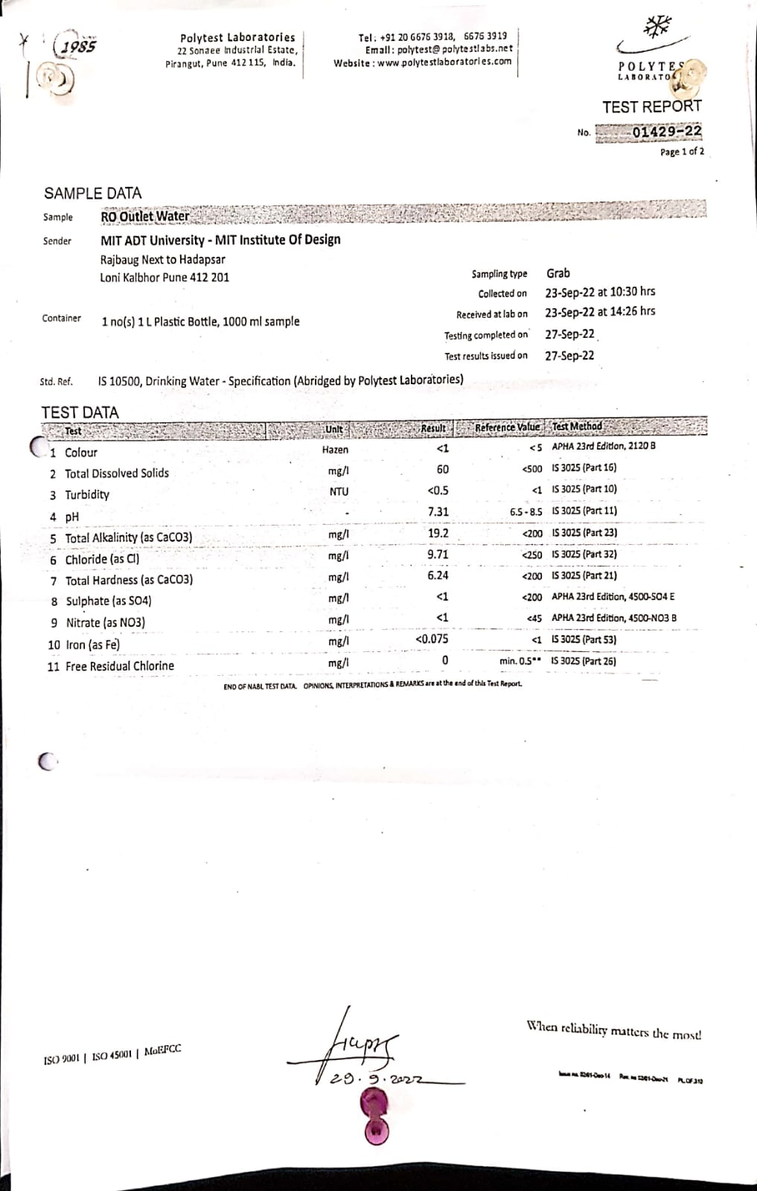
DRINKING WATER ANALYSIS REPORT.

Slide 10
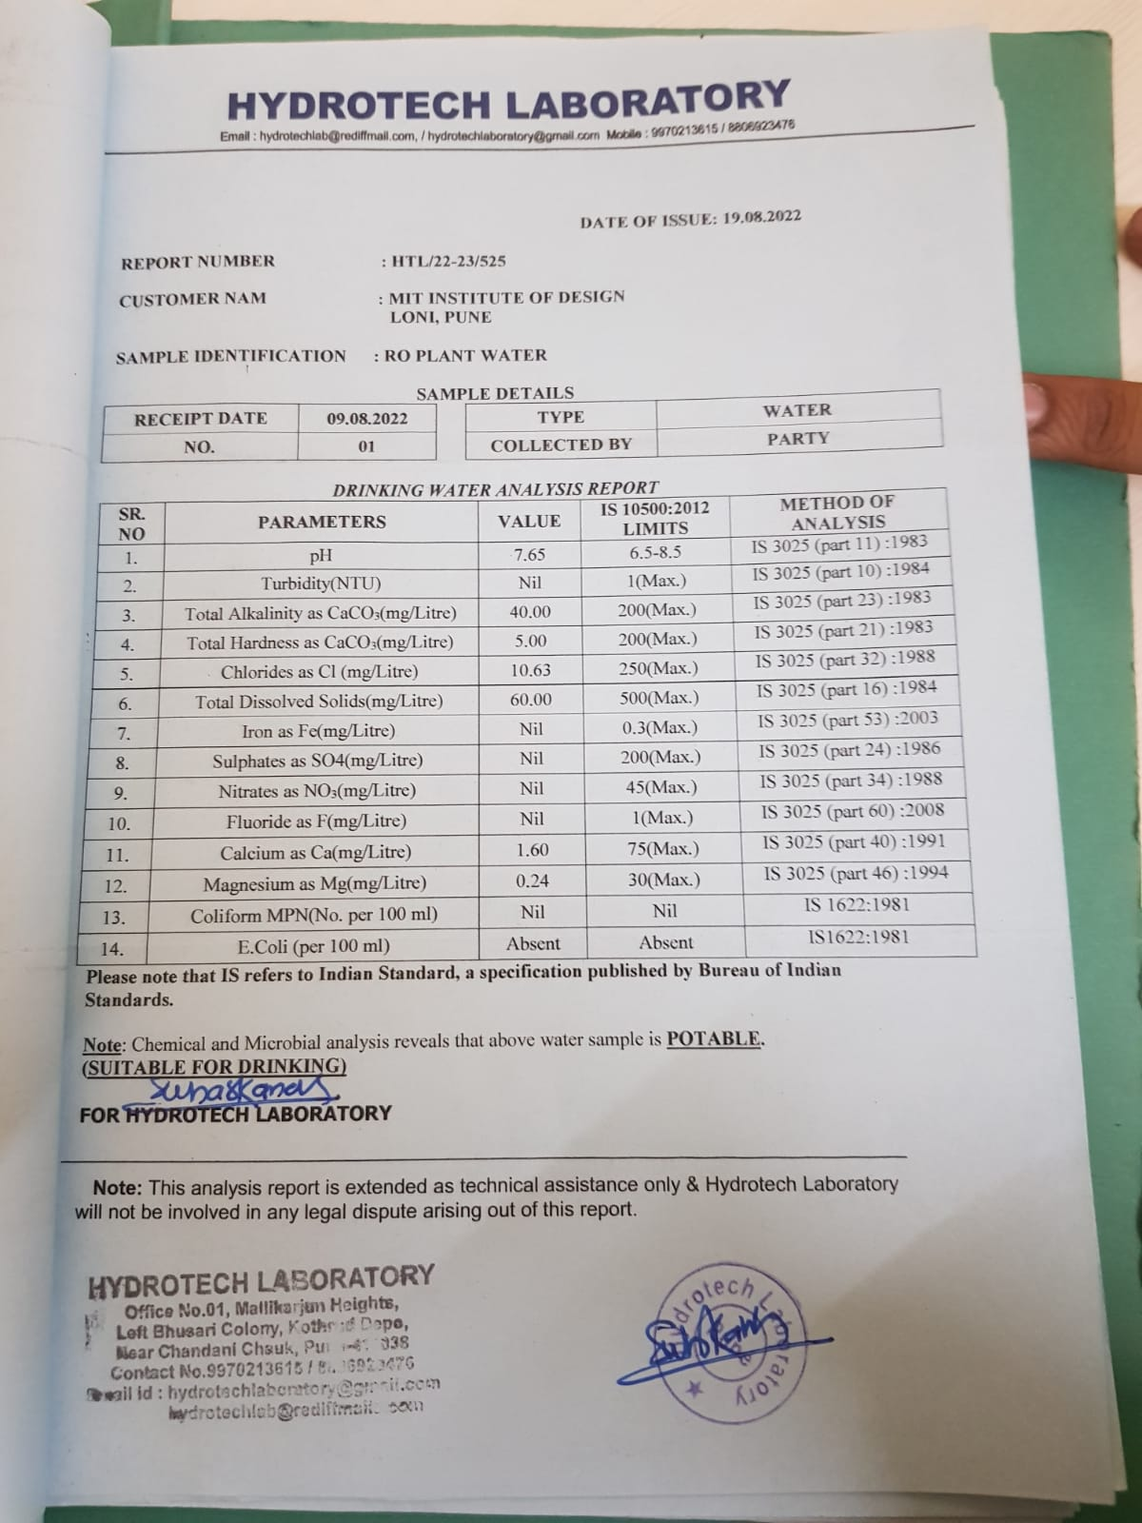
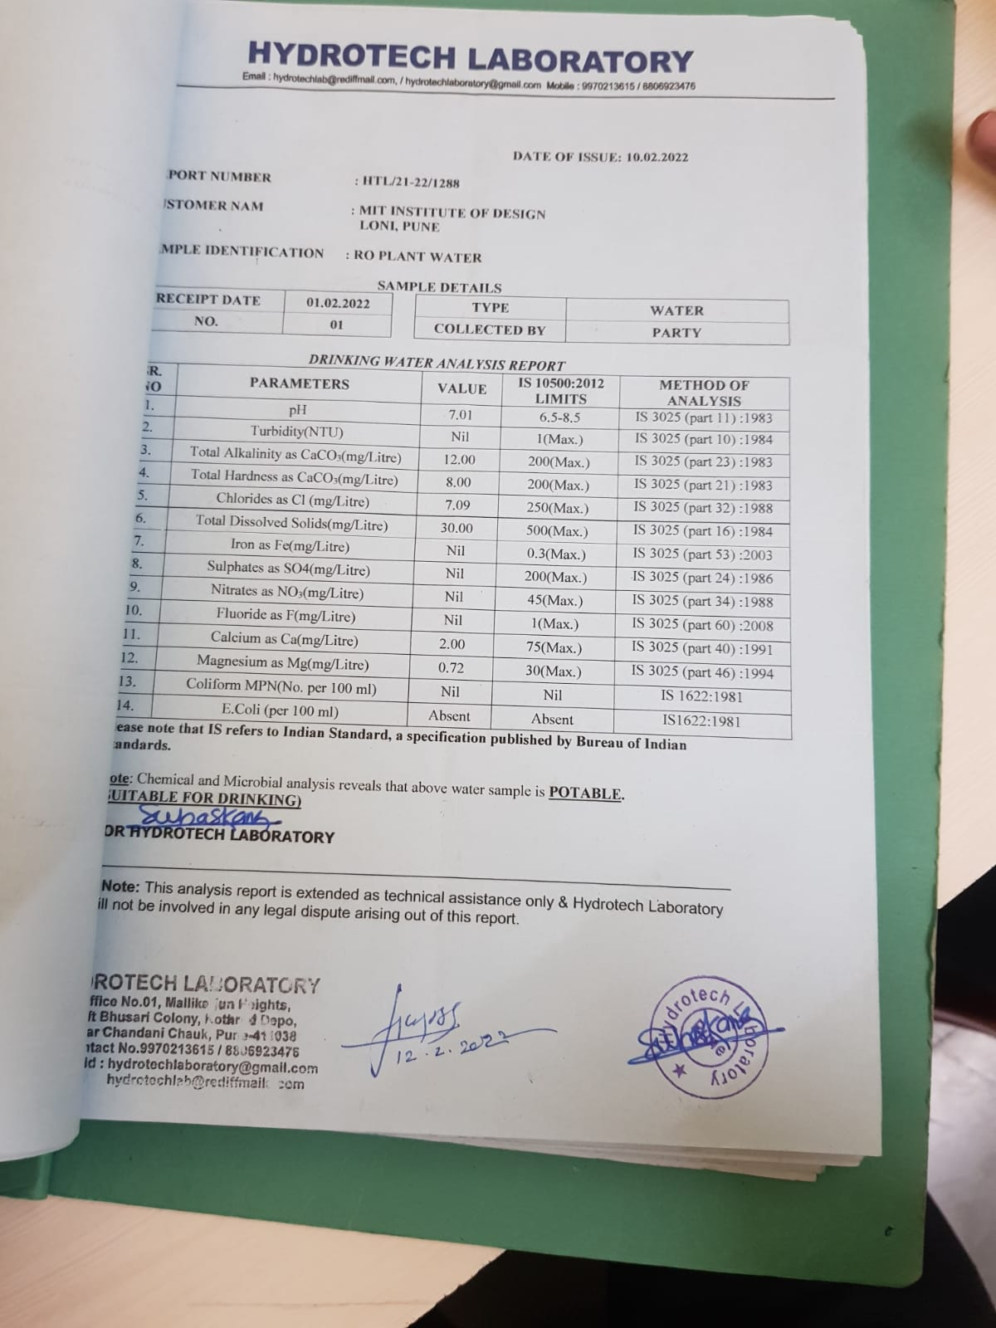

Slide 11
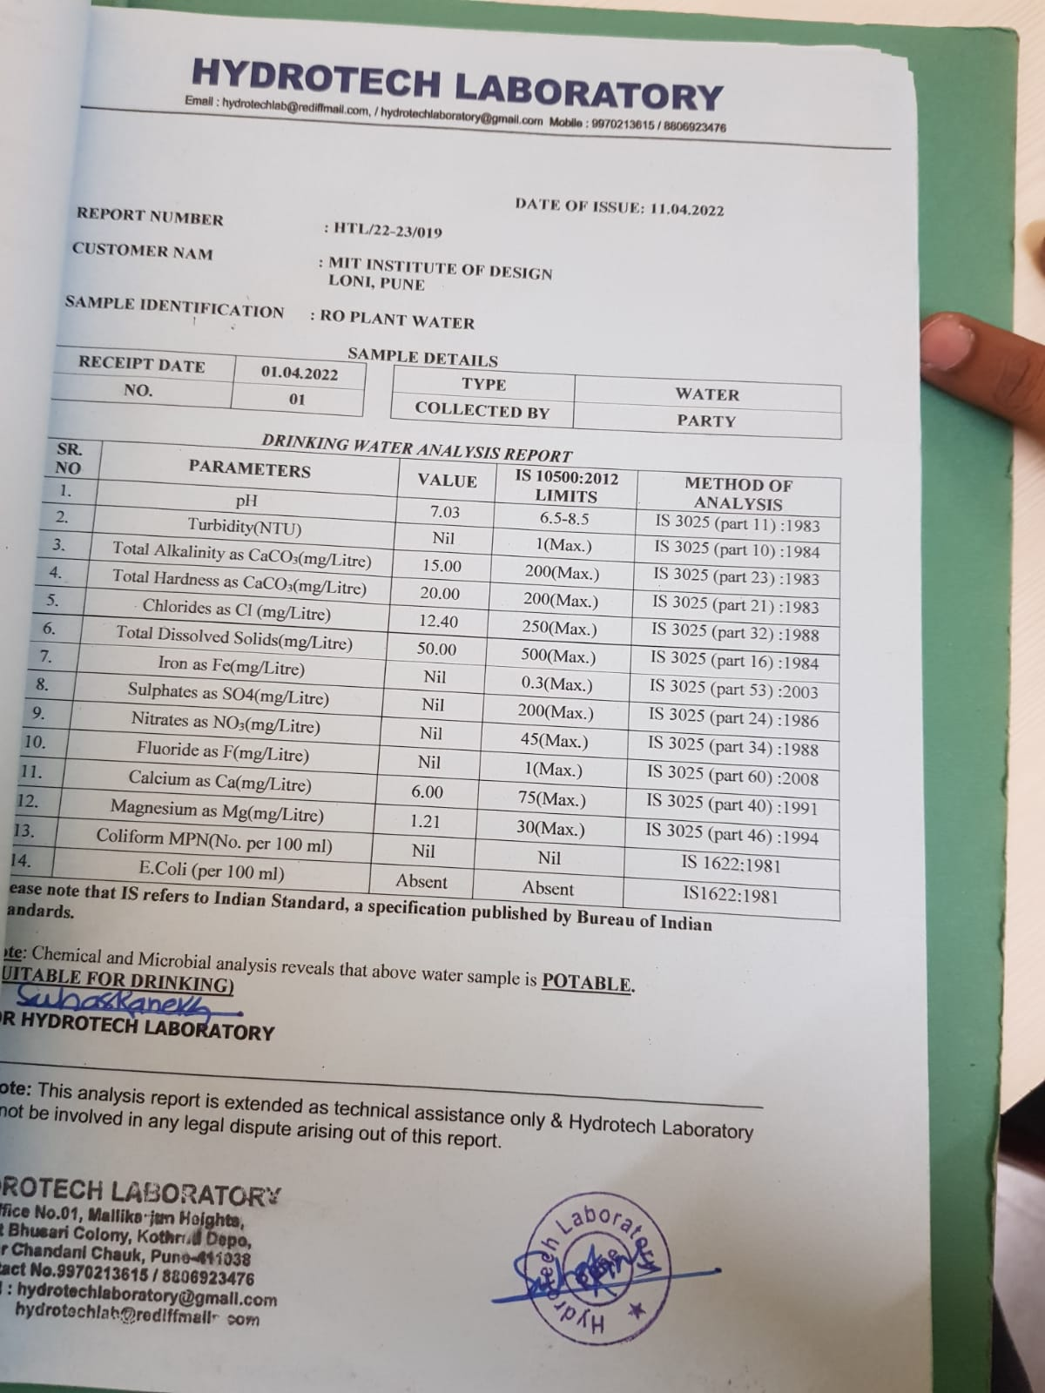
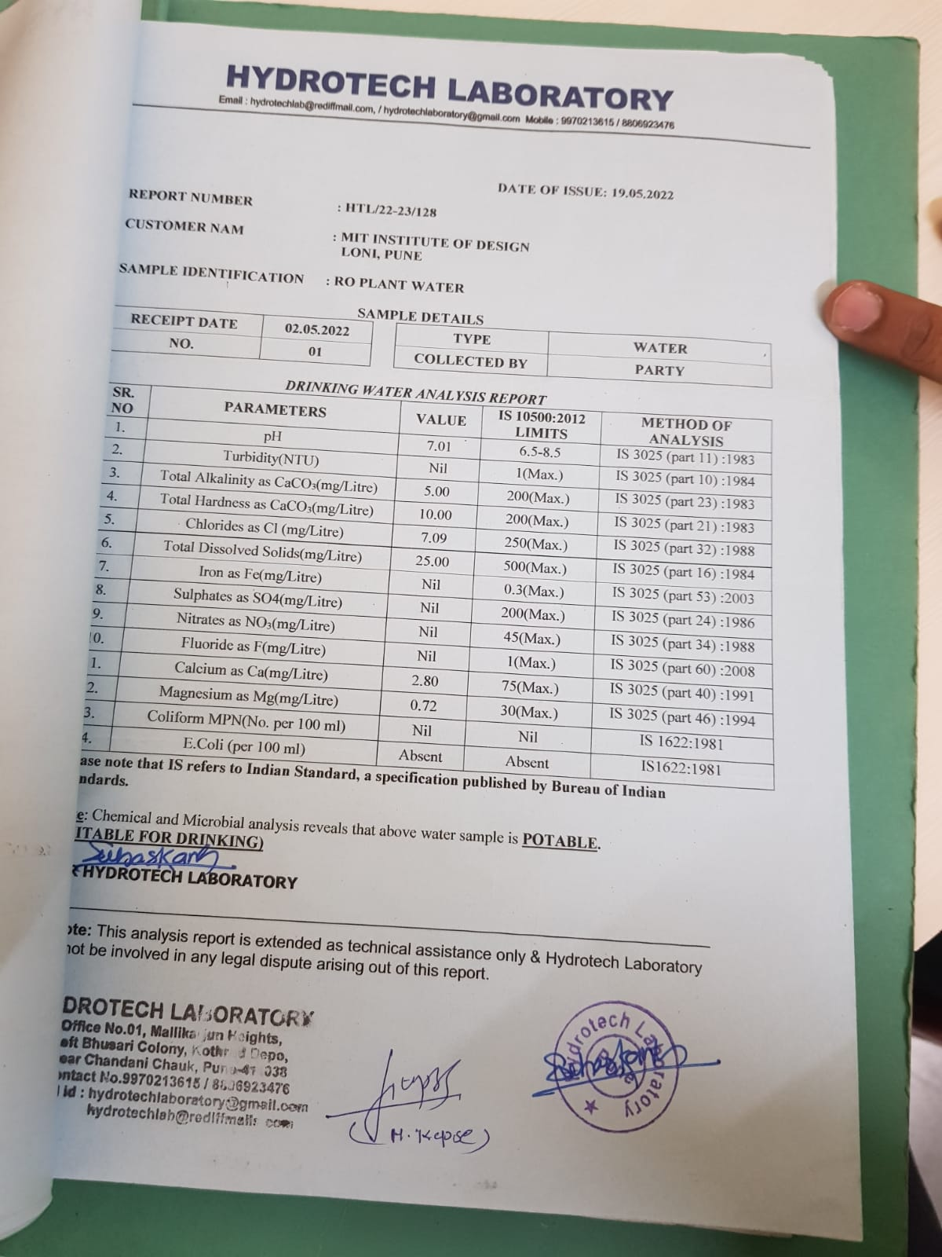

Slide 12
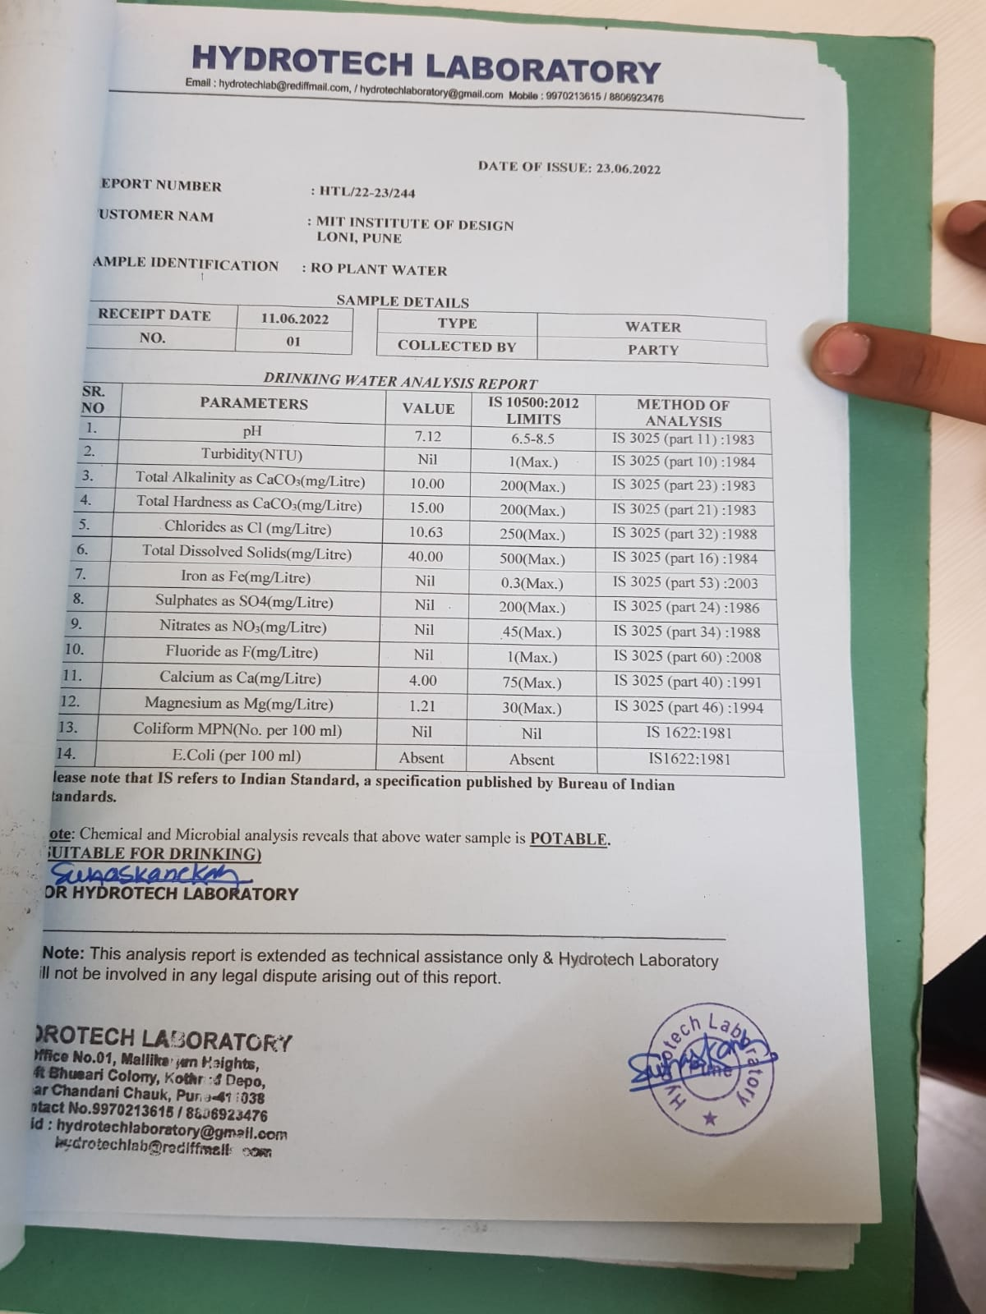
QUALITY OF WATER:-

Slide 13
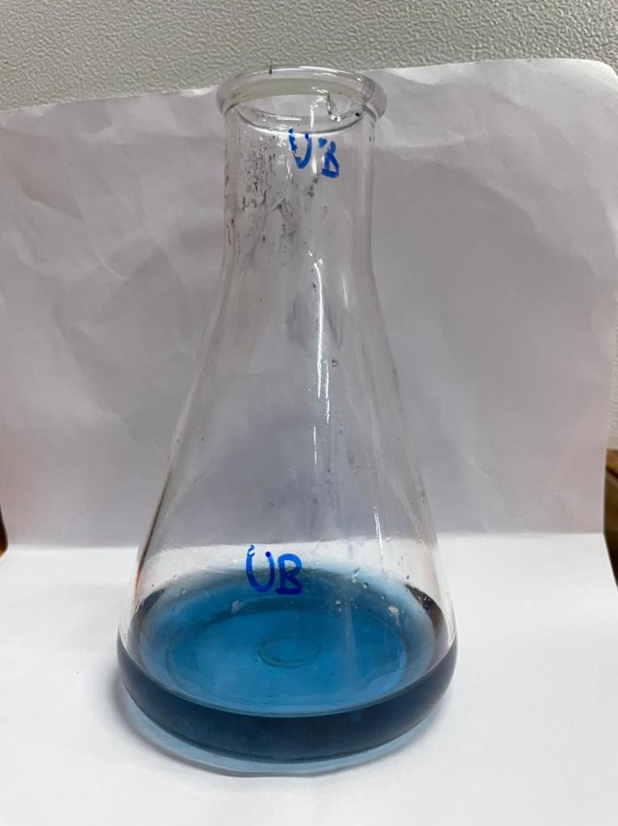
HARDNESS
Total Hardness Sample 50ml
5ml Buffer Solutuion
EBT Indicator = 0.01N
(color changes to wine)
Titration against EDTA
(color to blue)
Note the reading

Slide 14
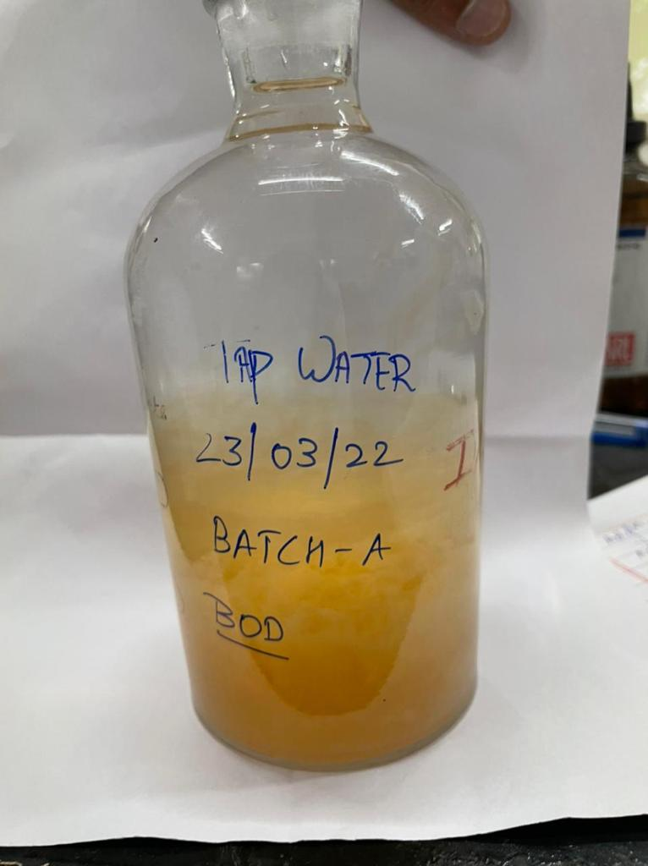
BOD:-
Sample 300ml
+
Alkali Iodine 2ml
+
MnSO4
Orange PPT settling
2 – 4 ml cone H2SO4
Shake
Take 203ml + Starch Indicator
Titrate against sodium sulphate
Titrate value x 0.2 x 1000
203

Slide 15
BOD OBSERVATION TABLE :-
Distilled water | 1.379 mg/l
Tap Water | 1.91 mg/l
Bore Water | 0.39 mg/l
Pilot Water | 1.18 mg/l
Drinking Water | 0.88 mg/l

Slide 16
TOTAL SUSPENDED SOLIDS (TSS):-
Take filter paper (dry)
Take wt. = B
At 1st wet it distill water
Then filter our sample 30ml
Dry filter paper in oven
Then,
Take wt. = A
TSS = (A-B)x100
vol. of sample

Slide 17
TSS CONTAIN:-
SAMPLE | Wt of filter paper before drying | Wt of filter paper after drying | (A-S)x1000 Vol of sample
Pilot plant (P.P) | 1.5 | 0.41 | 21.8
Drinking Water | 1.6 | 0.43 | 23.4
Bore water | 2.1 | 0.49 | 33.4
Tap water | 1.4 | 0.42 | 19.6
Distl. water | 1.5 | 0.47 | 20.6

Slide 18
Total Dissolved Solids (TDS):-
Wt. empty Prepare plate w,
Transfer 10ml sample in it
Put in Oven (for 30min)
Put in Desiccator
Wt. them w2
Now,
√ w2-w1x1000/vol of sample
Total Solids[TS] = TDS + TSS

Slide 19
TDS CONTAIN:-
SAMPLE | w1 | Presi DISTL. WATER | w2 | (w2-w1)x1000 Vol of sample
Distl. water | 43.72 | 53.8 | 43.72 | 0
Drinking water | 35.80 | 45.7 | 35.81 | 0.2
Bore Water | 44.29 | 54.31 | 44.31 | 2.2
Pilot Pant | 41.32 | 51.31 | 41.32 | 0
Tap Water | 41.90 | 50.9 | 41.91 | 0.2

Slide 20
ACIDITY
Methyl Orange
Sample 50ml
+
Methyl Orange Indicator
Titrate against 0.02 N NaOH
If the color does not change into faint pink then,
Phenolphthalein Acidity
Same flask + 2-3 drops of phenolphthalein Indicator
Titrate = Faint Pink
Formula = Titrate value(v2) x N. of NaOH(0.02) x1000
Volume of sample

Slide 21
ACID CONTAIN:-
SAMPLE | TOTAL ACIDITY
D/W | 12.5%
DRINKING WATER | 25%
TAP WATER | 50%
BORE WATER | 50%

Slide 22
Alkalinity
Phenolphthalein Alkalinity
50ml sample + phenol. Indicator
Titrate 0.01 N sulphuric acid
If it doesn't changes into faint pink color then,
rate the value = 0
Record value
Formula,
Titrate Value x N of H2SO4(0.01)x1000
Volume of sample

Slide 23
Total Alkalinity
Same flask + 2.3 drops of mixed indicator Titre
Light pink/ Orange in color
Record Value
formula =
Titrate Value x N of H2SO4(0.02)x1000
Volume of sample

Slide 24
TOTAL ALKALINITY:-
SAMPLE | TOTAL ALKALINITY
D/W | 10%
DRINKING WATER | 90%
TAP WATER | 510%
BORE WATER | 150%

Slide 25
CO2
100ml sample
+
Phenolphthalein indicator
If sample remains colorless,
CO2 is present
Titrate 0.05 N NaOH
changes into faint Pink
Titrate value x n. of NaOH x 1000 x 44
volume of sample

Slide 26
FREE CO2 DETERMINATION:-
SAMPLE | VOL OF TITRATE VALUE | Titrate value x n. of NaOH x 1000 x 44 volume of sample
Distill water | 0 | 0 mg/l
Drinking water | 0.3 | 6.6 mg/l
Pilot plant | 0.2 | 4.4 mg/l
Bore Water | 8.5 | 187 mg/l
Tap Water | 0.36 | 7.92 mg/l

Slide 27
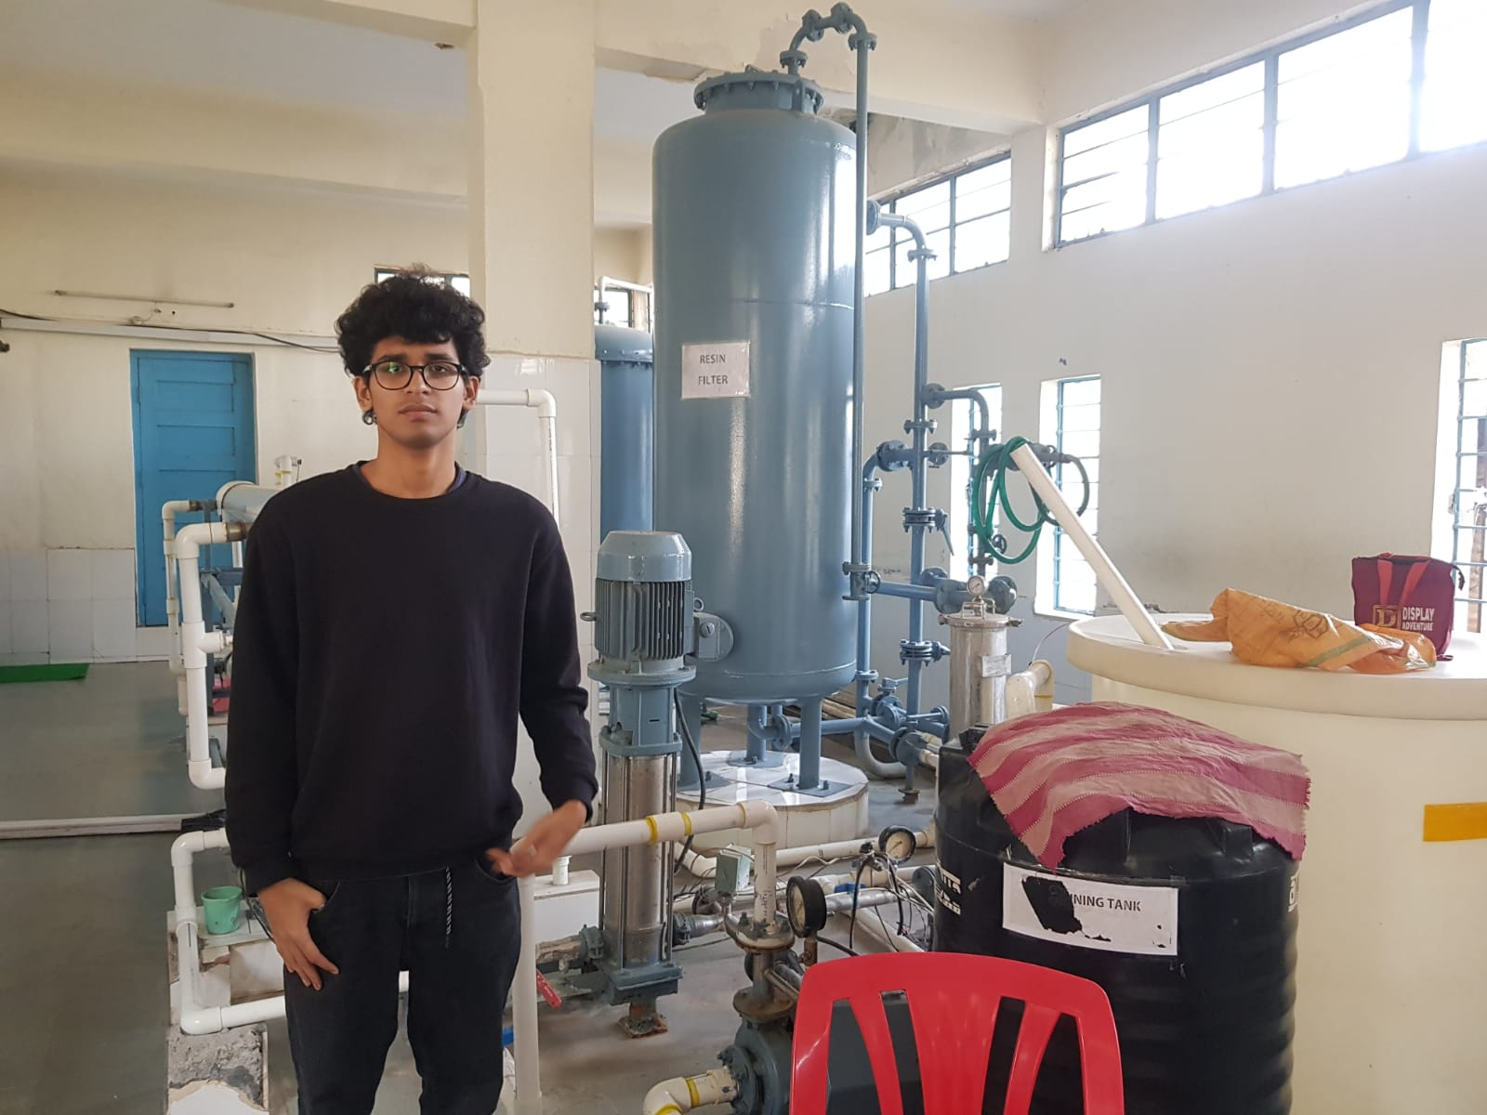
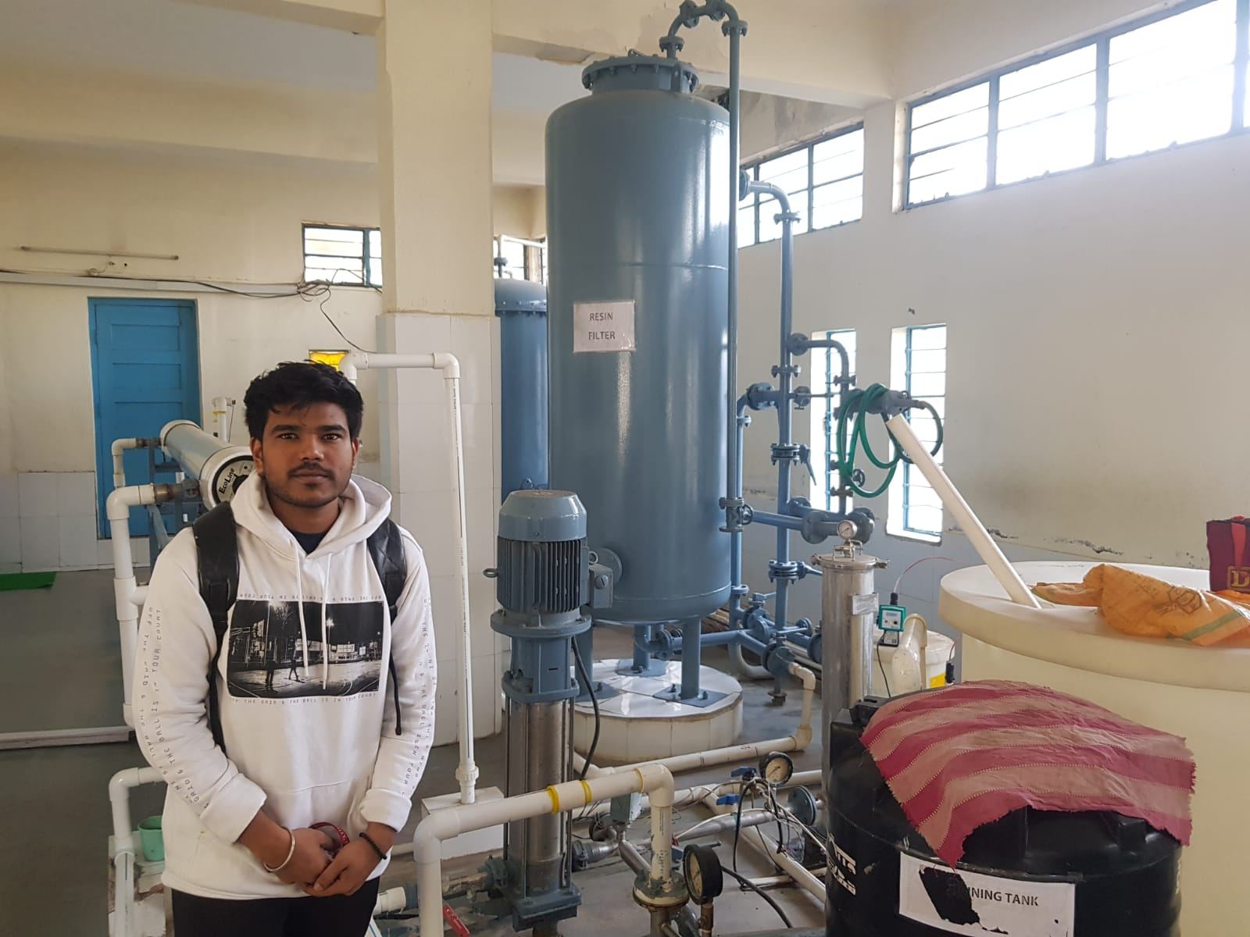
visit to MITADT water treatment plant.

Slide 28
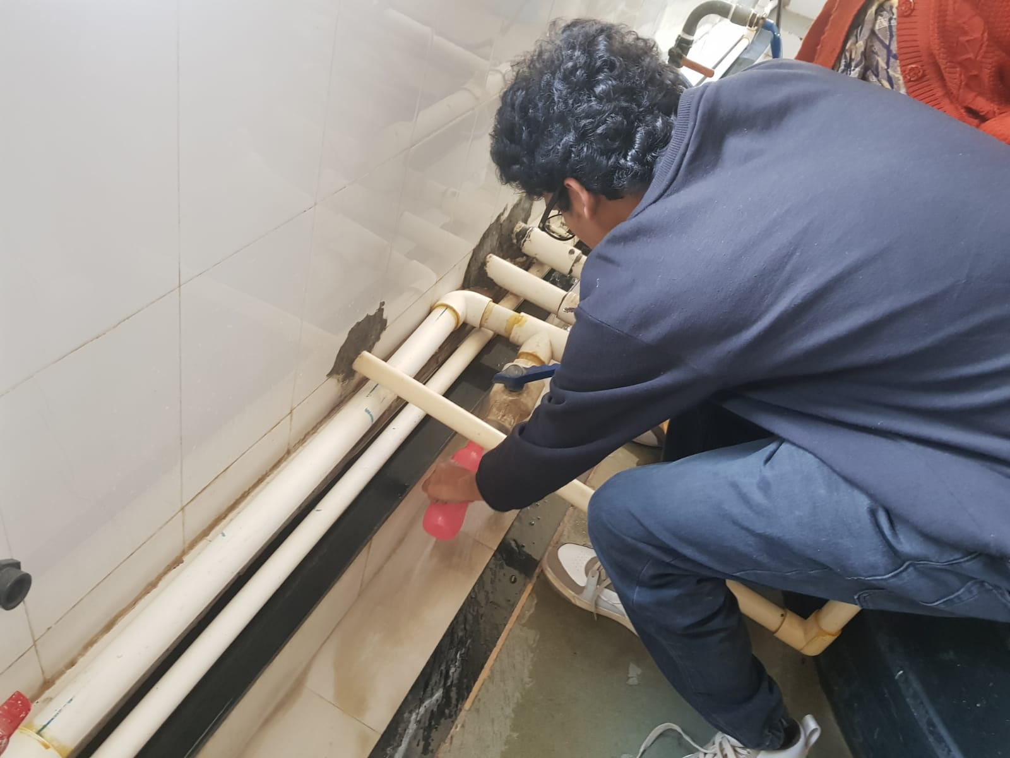
Collection of Bore Water sample

Slide 29
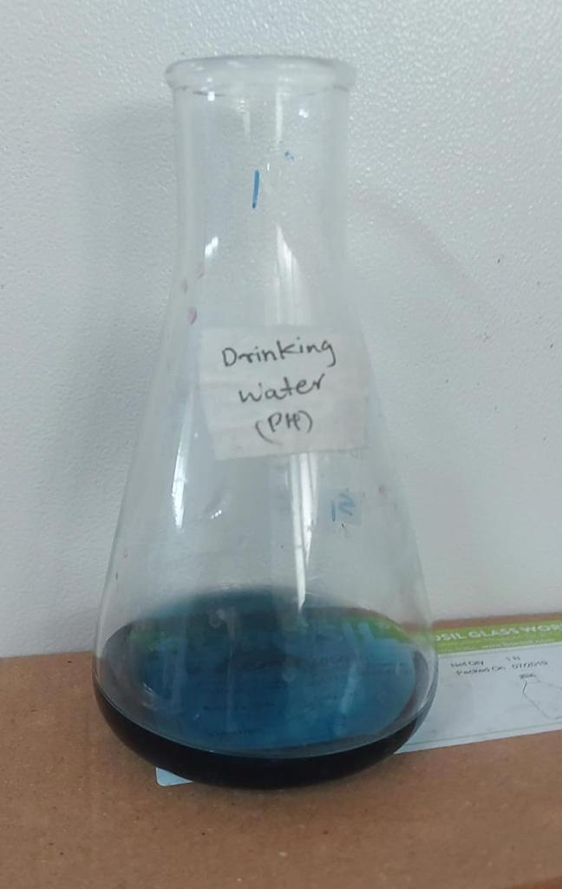
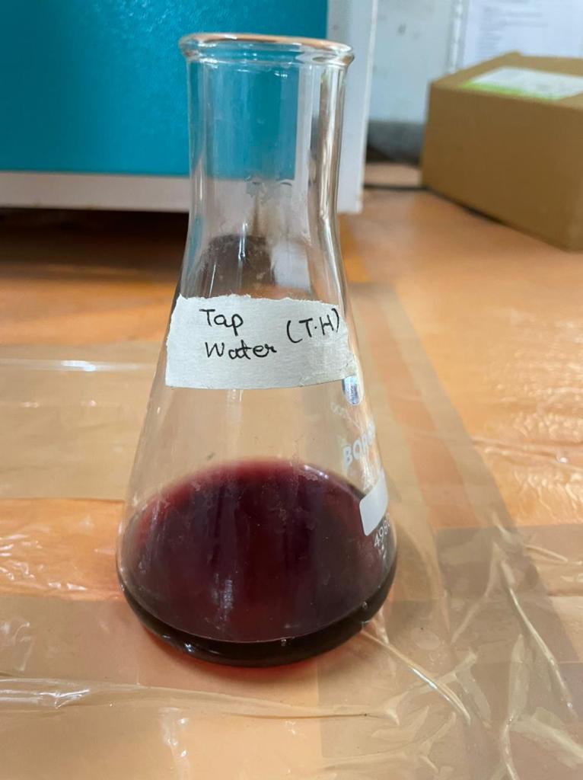
Test Performance on collected water sample

Slide 30
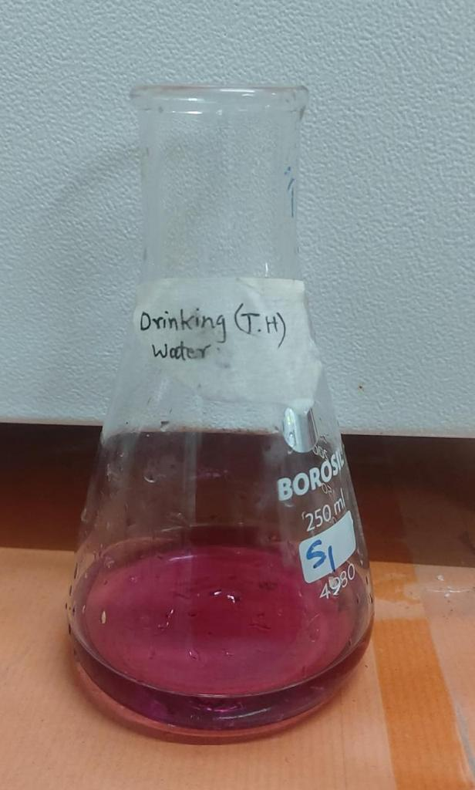
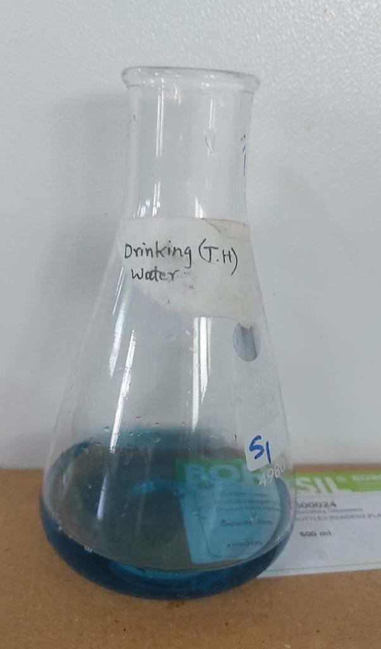
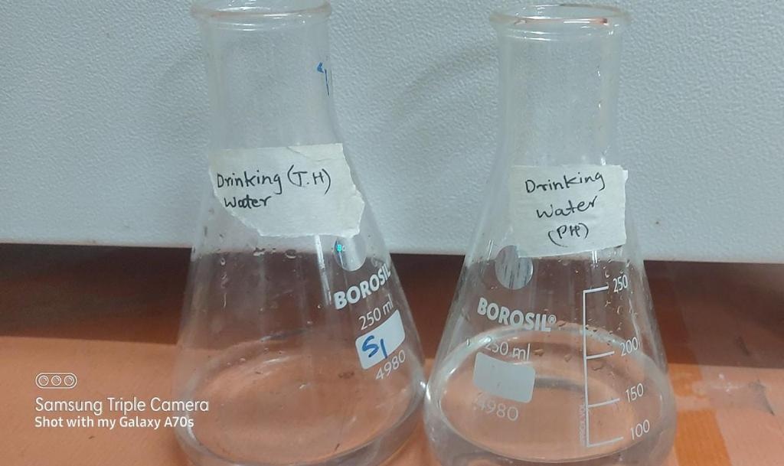
Test Performance on collected water sample

Slide 31
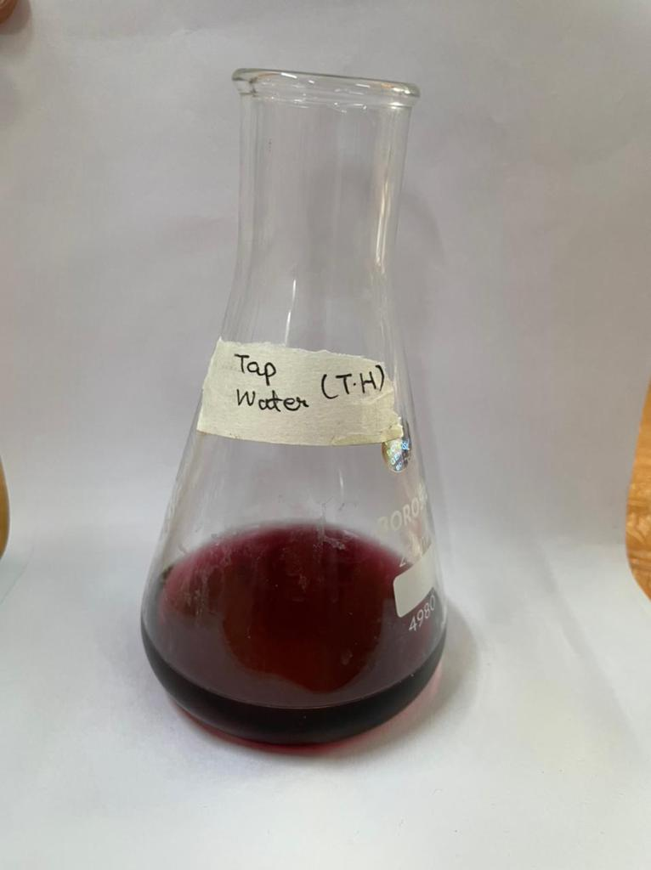
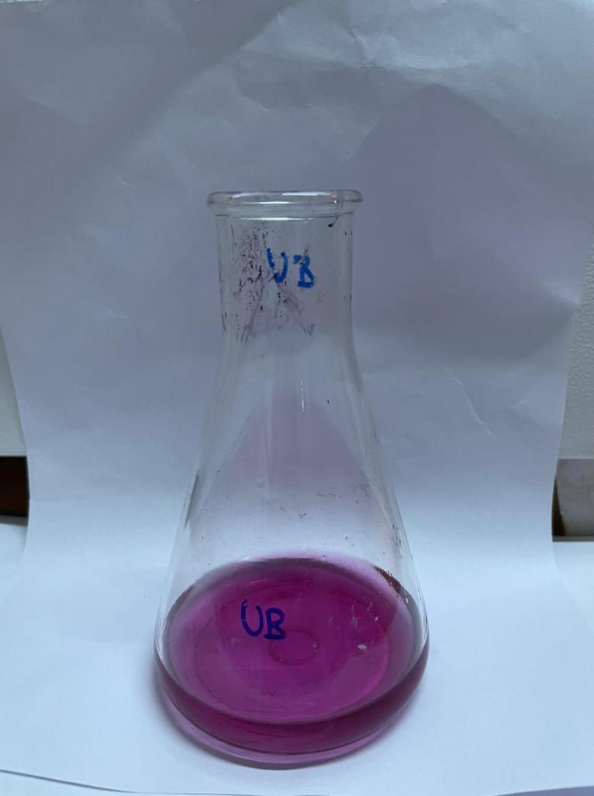
Test Performance on collected water sample

Slide 32
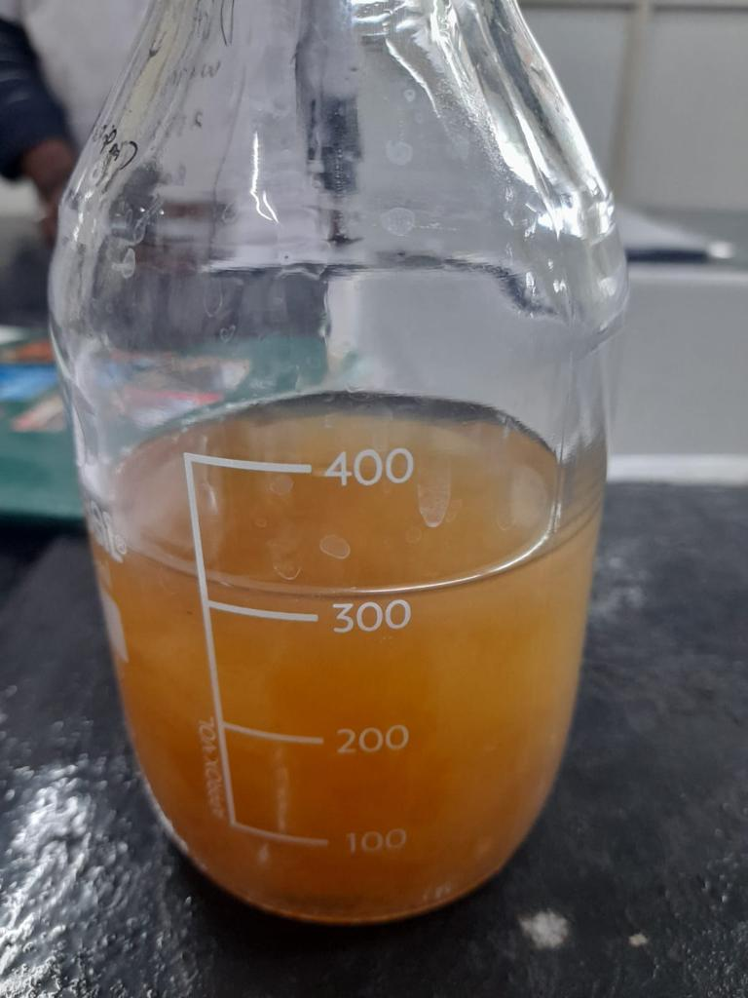
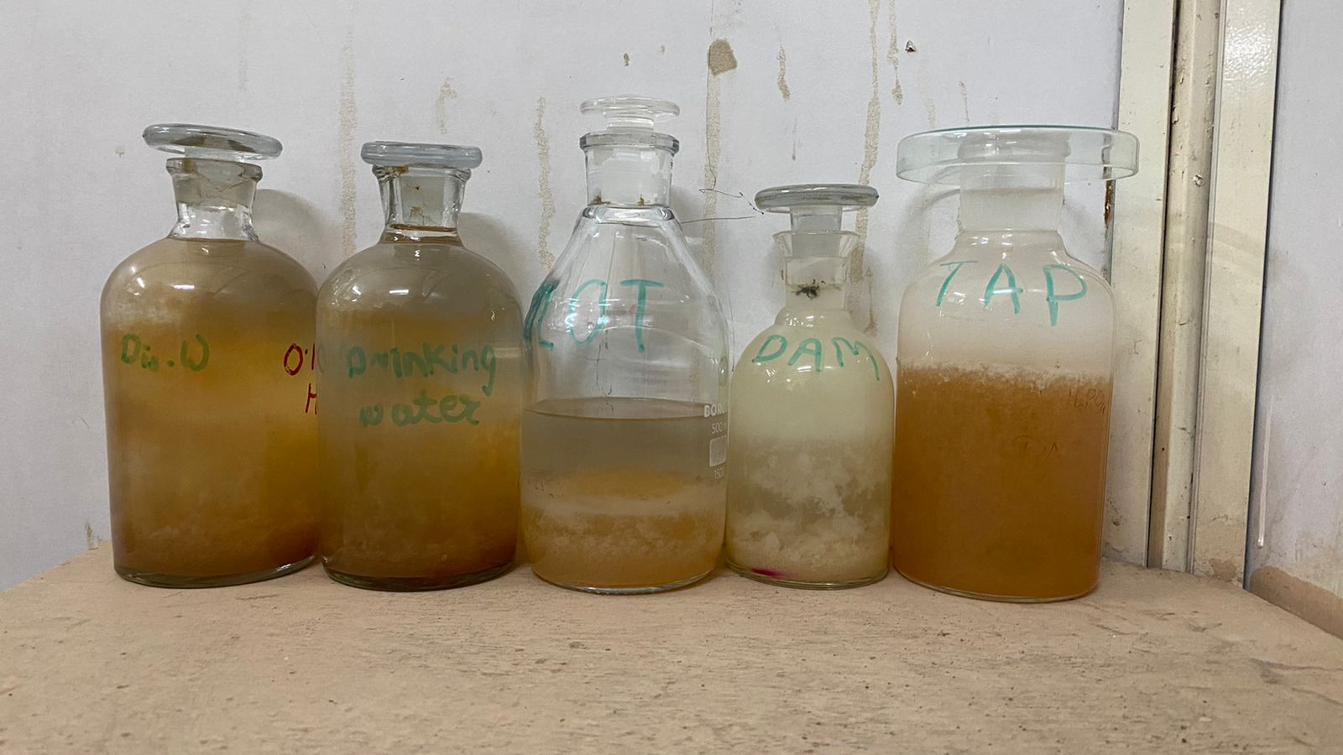
Test Performance on collected water sample

Slide 33
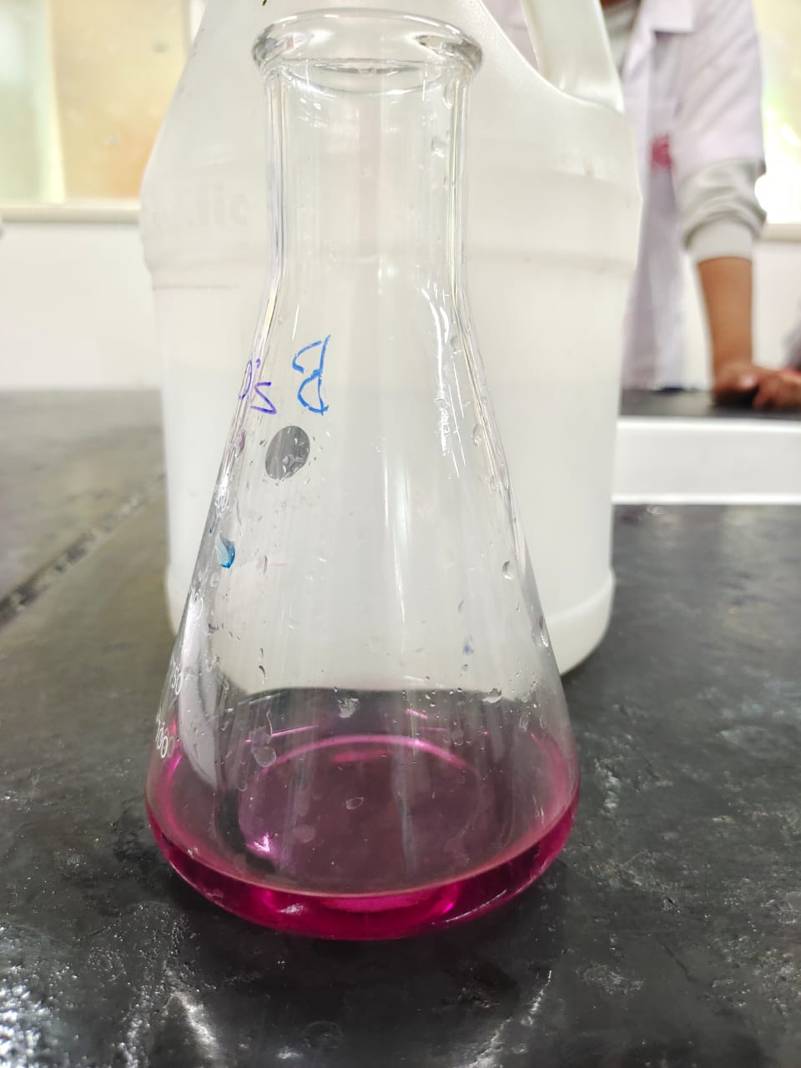
Test Performance on collected water sample

Slide 34
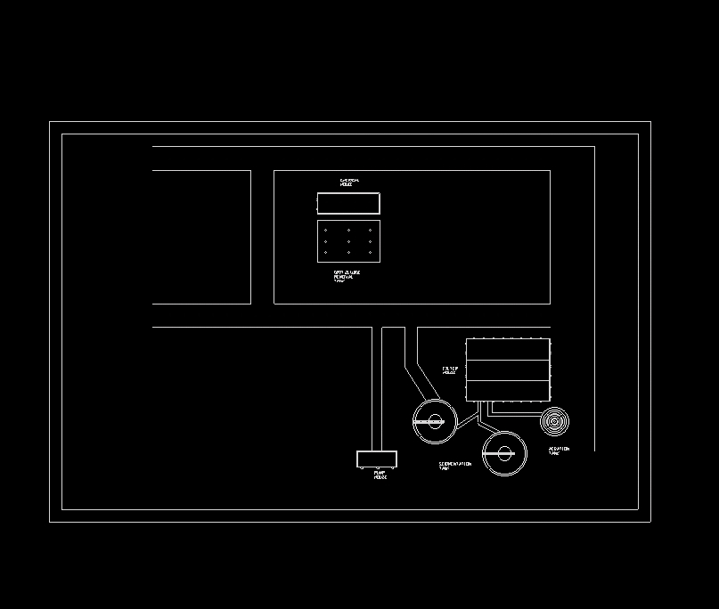
PLAN OF THE UNIT (IN PROGRESS) :-

Slide 35
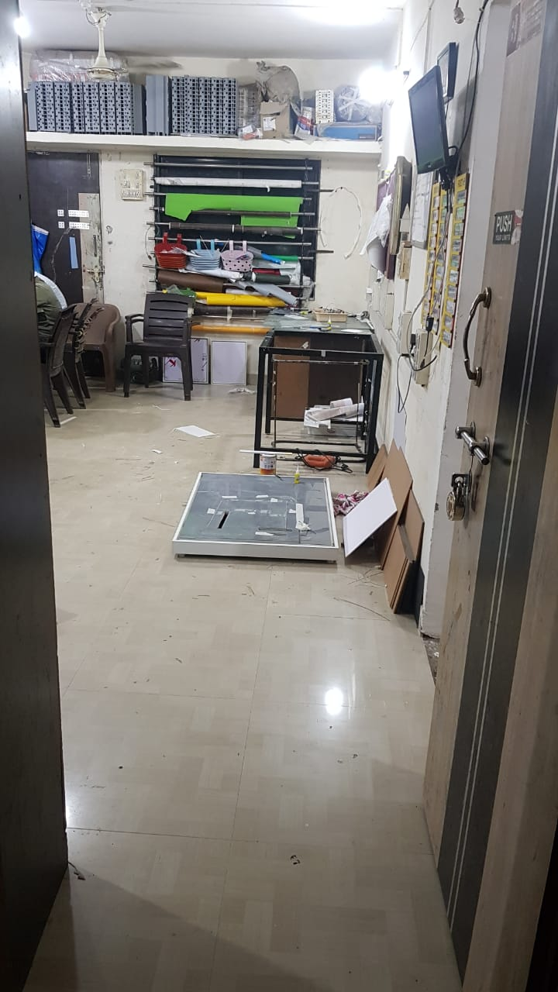
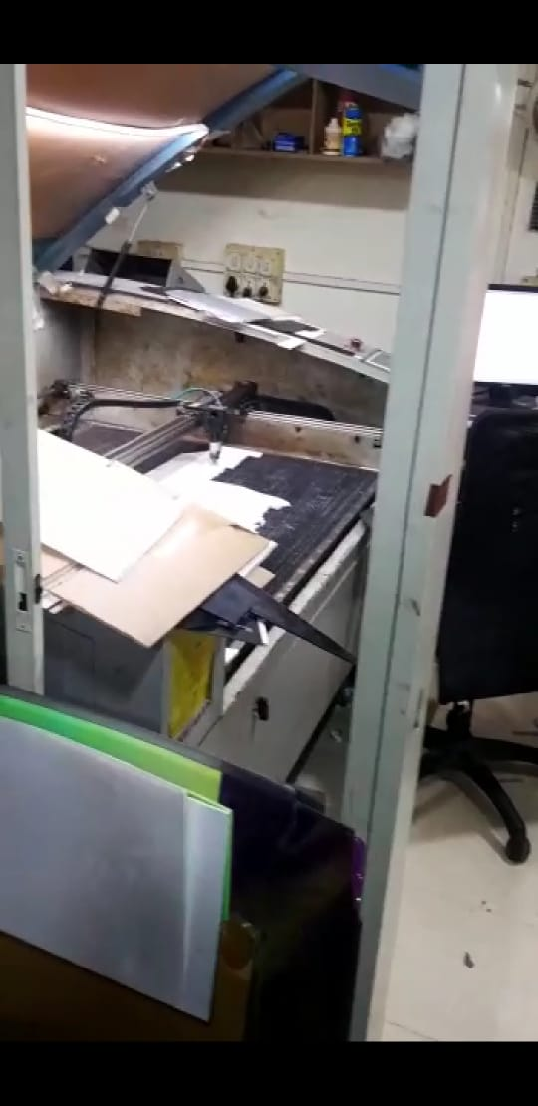
Pictures of model making (in progress)

Slide 36
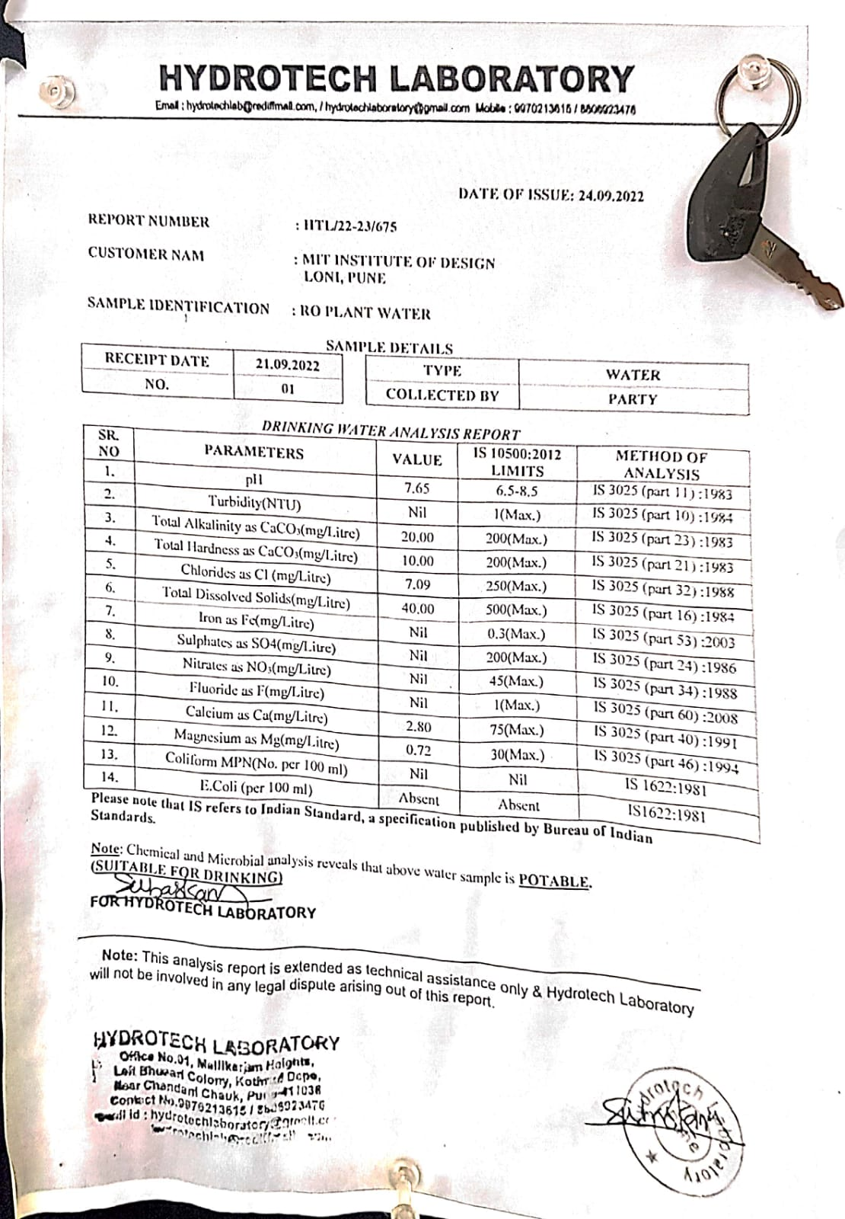
DRINKING WATER ANALYSIS REPORT.

Slide 37
REFRENCES:-
Bartram J, Corrales L, Davison A, and Deere D. – “ Water Safety plan Manual: Step-by-step risk management for drinking-water suppliers”, – World Health organisation, Geneva, 2009
BIS – IS: 1172: 1993 – “Code of Basic Requirements for Water Supply, Drainage and Sanitation” – Fourth Revision, February 1993
Ministry of Human Resources Development, Government of India - “Unnat Bharat Abhiyan” – UBA Brochure, 2016-1
Reports of water quality from MIT ADT UNIVERSITY.

Slide 38

THANK YOU……!

